Slide 1

Group No: -
C15
A
seminar on
Prepaid Energy Meter and Theft Detection
Guide :-
Ms. Archana Deokate
Presented By:-
Himanshu Dudhe
Rushabh Chikane
Abhishrut Giradkar
Category: In-house
Department of Electronics & Telecommunication Engineering
Smt. Kashibai Navale College of Engineering, Pune - 41.

Slide 2
CONTENTS
Aim
Abstract
Objective
Introduction
Literature Survey
Block Diagram and Description
Hardware/ Software Design
Working principle
Advantages/ Limitations/ Applications
Conclusions
References
Phase Wise Plan

Slide 3
Aim
The project smart electricity meter aims at making the energy billing prepaid.
Our system will implement centralized monitoring of energy consumption, while making it prepaid.
The user can be made more conscious, as the system is prepaid, thereby reducing energy wastage.

Slide 4
ABSTRACT
The restructuring of the Maharashtra State Electricity Board is changing the power scenario in the state. Within a span of one year, the restructuring has started yielding good results and there seems a great promise for the future of the power sector in the state. Proper restructuring of an electrical utility is possible only by proper analysis of the randomly varying parameters of the entire system. The analysis of these randomly varying parameters is done using various statistical methods.

Slide 5
OBJECTIVES
To built the project smart electricity meter aims at making the energy billing prepaid.
To made user more conscious, as the system is prepaid. thereby reducing energy wastage.
To track and record the use of electricity in customers' homes by smart electric meters.
To reduce traditional billing contains wastage of time and resources as well, in auto billing system there is no more need of the manual meter readings and bill slips.

Slide 6
INTRODUCTION
Most of the energy meters are designed to bill as per the units of energy consumed.
These meters need to be manually read by people in order to provide monthly bills.
We here propose a smart electricity meter. The system is designed to allow amount of energy to be used as long as the account has balance pending.
The system first accepts account recharge and allows to use only limited units of energy as per recharge and then cuts off the supply.
The prepaid electricity billing meter could be widely used to provide a new more customized electricity billing system, where users may recharge when they intend to use that facility

Slide 7
LITERATURE SURVEY
Birendrakumar Sahani.al[1] are made a practical model of IoT Based Smart Energy Meter. The proposed model is used to calculate the energy consumption of the household, and even make the energy unit reading to be handy. It reduces the wastage of energy and bring awareness among all. Mayur Rawte.al[2] are developed a system to solve many problems such as over usage of electricity, large amount of manpower transparency of usage and wastage of money and resources etc.This technology allows verified customers to check status of electricity usage by using Device identification number and password in real time. This can be done from web application using Internet. Nazmat Toyin.al[3] are designed the system to resort to a local server and database, upon resumption of internet connection, all information are synchronized with the web server. The billing is handled locally by the web server and has not been interfaced with any online payment platform agencies.

Slide 8
LITERATURE SURVEY
Mst. Shahnaj Parvin.al[4] are explained the framework and how it will be beneficial in detecting an unauthorized use of electricity. The relative advantages of the proposed system over conventional systems have also been outlined in the paper. Azfar Tufail.al [5] provide some enhancement in the conventional Metering system by smart metering. The term Smart Meter is an advanced energy meter that measures consumption of electrical energy providing additional information compared to a conventional energy meter.

Slide 9
LITERATURE SURVEY
Omijeh.al[6], introduced a tamper detect feature for a ESP8266 solution for prepaid energy meter, however this work didn’t provide an interactive interface for real-monitoring, access control as well as a robust database.

Slide 10
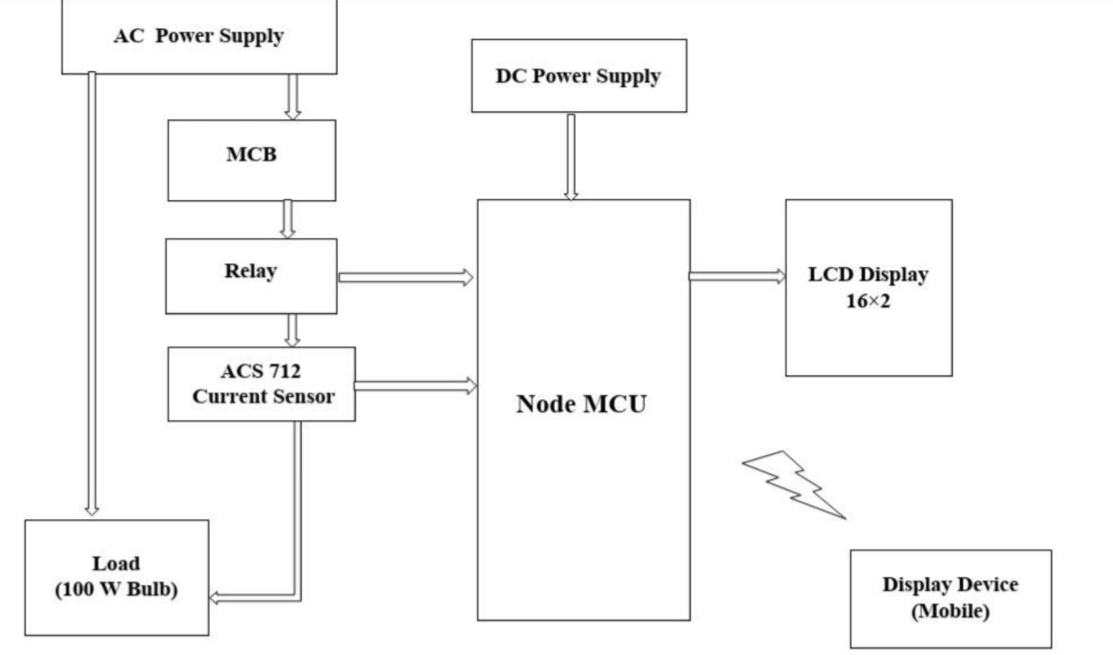
BLOCK DIAGRAM
Fig. 1 Block Diagram of Prepaid Energy Meter

Slide 11
BLOCK DIAGRAM DESCRIPTION
Components used in Project :
Node MCU
Relay
16x2 LCD Module
MCB
Diode 1N4007
COPPER PCB
ACS712 Current Sensor

Slide 12
BLOCK DIAGRAM DESCRIPTION
NodeMCU with ACS712 Current Sensor, is the current sensor will measure the current consumed by our AC load and the NodeMCU will measure this current, calculate the power and send the power value to a cloud platform.
It also consists of a ESP8266 module that allows the operator to recharge the meter remotely using email message service. This puts forward an innovative electricity billing and “use as needed” electricity usage scheme. It also eliminates the need for manual electricity meter reading tasks.
ACS712 Current Sensor Module : The ACS712 is a fully integrated, hall effect-based linear current sensor with 2.1kVRMS voltage isolation and a integrated low-resistance current conductor.

Slide 13
BLOCK DIAGRAM DESCRIPTION
Relay : It consists of a set of input terminals for a single or multiple control signals, and a set of operating contact terminals.
Relay driver circuit
16x2 LCD Module : A 16X2 LCD has two registers, namely, command and data. The register select is used to switch from one register to other. RS=0 for command register, whereas RS=1 for data register.
MCB : A miniature circuit breaker automatically switches off electrical circuit during abnormal condition of the network means in over load condition as well as faulty condition.

Slide 14
HARDWARE SPECIFICATIONS
ESP8266 : The ESP8266 is a low-cost Wi-Fi microchip, with built-in TCP/IP networking software, and microcontroller capability, produced by Espressif Systems in Shanghai, China
ACS712 Current sensor : ACS712 is a current sensor that can operate on both AC and DC. This sensor operates at 5V and produces an analog voltage output proportional to the measured current.
16 x2 LCD : 16×2 LCD is one kind of electronic device used to display the message and data. The term LCD full form is Liquid Crystal Display. The display is named 16×2 LCD because it has 16 Columns and 2 Rows.

Slide 15
HARDWARE SPECIFICATIONS
• Copper clad PCB Board : Copper-clad boards are simply PCB laminates that can be used in a board stackup as part of the etching process.
Bulb used as a load.
Resistor, Transistor And Capacitor .

Slide 16
SOFTWARE SPECIFICATION
Proteus:
The Proteus Design Suite is a proprietary software tool suite used primarily for electronic design automation. The software is used mainly by electronic design engineers and technicians to create schematics and electronic prints for manufacturing printed circuit boards.
Dip Trace:
DipTrace is an EDA/CAD software for creating schematic diagrams and printed circuit boards. The developers provide a multi-lingual interface and tutorials (currently available in English and 21 other languages). DipTrace has 4 modules: schematic capture editor, PCB layout editor with built-in shape-based autorouter and 3D-preview & export, component editor, and pattern editor.

Slide 17
WORKING PRINCIPLE
When we power up the system then it reads checks the available balance with the predefined value and take action according to them, like if available balance is greater than 20 rupees then microcontroller turns ON the electricity of home or office by using relay. And if balance is less than 20 rupees then microcontroller sends a notification to user phone regarding low balance alert and requesting to recharge soon. And if balance is less than 20 rupees then microcontroller turns OFF the electricity connection of home and sends a notification to users phone for Light Cut alert and requesting to recharge soon. Energy meter monitoring is completely done by Android application. The following specification are developed for Android Application to control and monitoring the meter.

Slide 18
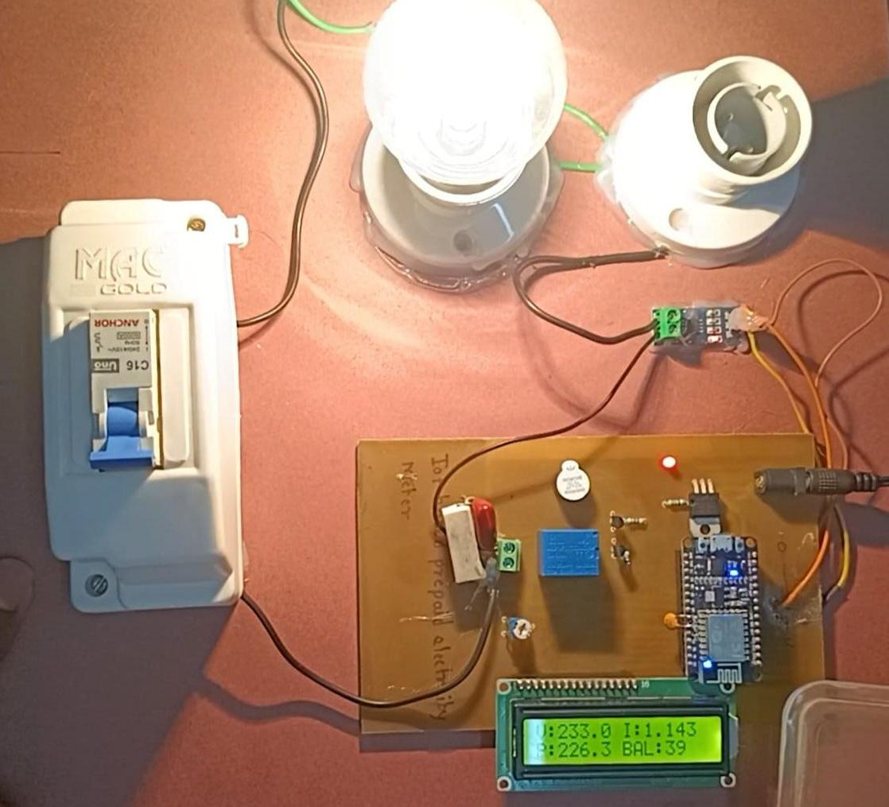
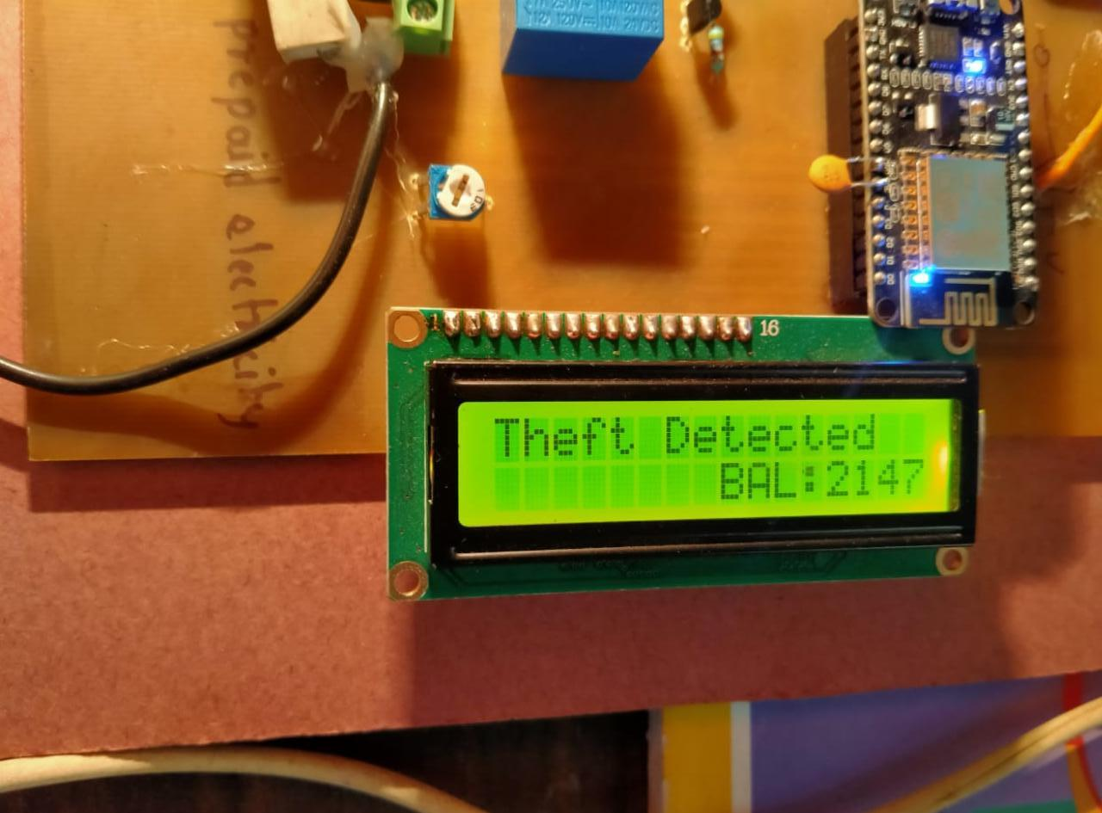
RESULTS

Slide 19
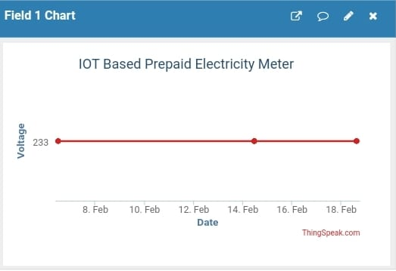
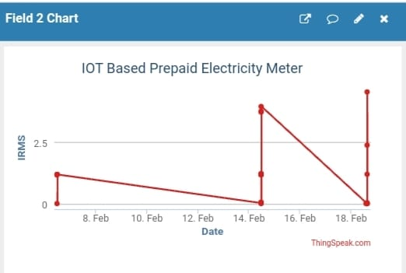
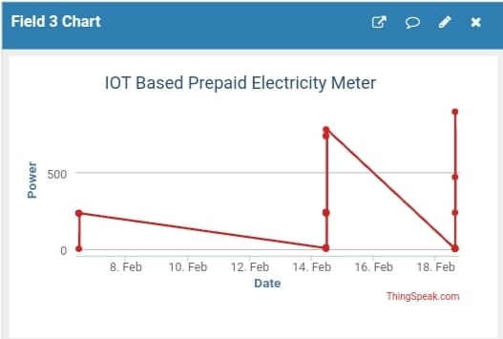
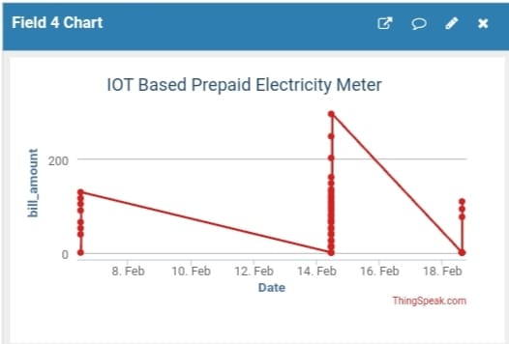
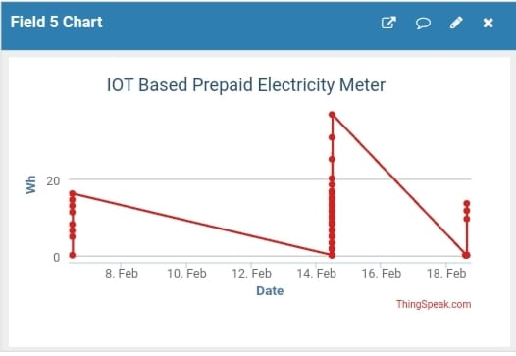
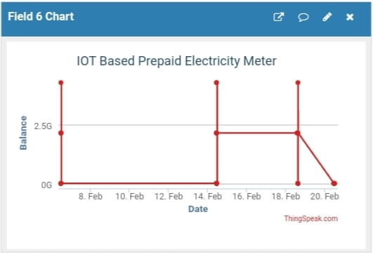
RESULTS

Slide 20
ADVANTAGES
It is highly accurate as the whole idea of reading the units and then billing automatically.
Consumer cannot escape from paying the electricity bill and the State Electricity Board gets free from debts.
Wastage of energy is diminished as now only the required energy will be consumed as allotted.
The power grid can monitor the overall energy consumption and prevents from any damages to the circuit.

Slide 21
LIMITATIONS
You must maintain your account balance at or above the disconnection balance, otherwise your service may get disconnected.
Charges may be applicable for network use.

Slide 22
APPLICATION
Portable energy and power meters
Grid monitoring
Smart energy meter
Its applications include shopping malls residential townships, commercial buildings, employee quarters etc.

Slide 23
CONCLUSIONS
IoT based meter is more useful to consumer for billing and maintaining less bill payment and it decreases the human needs for paying and other issues related to billing.
We can extend it for industrial purposes also by interfacing three phase meters but the circuit have to modify for getting proper voltage to the controller.

Slide 24
FUTURE SCOPE
Power factor must be measured by different techniques. Smart energy Meter can be modified for the detection of illegal use of electricity.
With Data analysis energy distribution can be done .

Slide 25
PHASE WISE PLAN
Sr. No | Activity | Date | Remarks
1. | Registration of Project Groups
2. | Finalization of Project Guide
3. | Reporting to Respective Project Guides
4. | Discussion of Project idea /Topics (At least 3)
5. | Submission of Abstract and Synopsis to project Guides and Project Coordinator in Prescribed Format
6. | Literature Survey ( At least 10 IEEE or similar Papers)
7. | Simulation Results
8. | Presentation on Selected Topic in front of committee members (Ist Presentation)

Slide 26
PHASE WISE PLAN
Sr. No | Activity | Date | Remarks
9. | Presentation on Project Topic in front of committee members (Presentation-III)
10. | Presentation on Project Topic in front of committee members (Presentation-IV)
11. | Submission of Draft Copy of Project Report to Project Guide.
12. | Preparation of survey paper based on project topic.
13. | Project Exhibition by all Groups and Evaluation
14. | Submission of Project Report and Project Book.

Slide 27
REFERENCES
[1] Mst. Shahnaj Parvin and S. M. Lutful Kabir, A Framework of a Smart System for Prepaid Electric Metering Scheme,
[2] Birendrakumar Sahani and Tejashree Ravi and Akibjaved Tamboli And Ranjeet Pisal, IoT Based Smart Energy Meter, International Research Journal of Engineering and Technology (IRJET) Volume: 04 Issue: 04 Apr -2017.
[3] Mayur Rawte and Shrishti Sharma And Praveen Lalwan ,Smart Prepaid Energy Meter based on Internet of Things, International Journal of Computer Applications Volume 171,No.2, August 2017.

Slide 28
REFERENCES
[4] Nazmat Toyin SURAJUDEEN-BAKIND and Sunday Olufenka AYO- DELE and Timilehin David OLORUNTOBA and Abdulrahaman Okino OTUOZE and Nasir FARUK, , Development of an Internet Based Prepaid Energy Meter,IEEE Africon 2017 Proceedings. [5] Tufail Azfar and Naeem Hummayoun Advance enegy meter for smart metering system: an operational perspective,IOSR journal of Electrical and Electronic Engineering. (June 2016). [6] Omijeh, B. O. and Ighalo, G. I. Modelling of ESP8266-Based Energy Recharge Scheme for Prepaid Meter,Journal of Electrical and Electron- ics Engineering vol.4, pp. 46-52, 2013.

Slide 29
THANK YOU.

